Slide 1
IoT Hacking

Slide 2
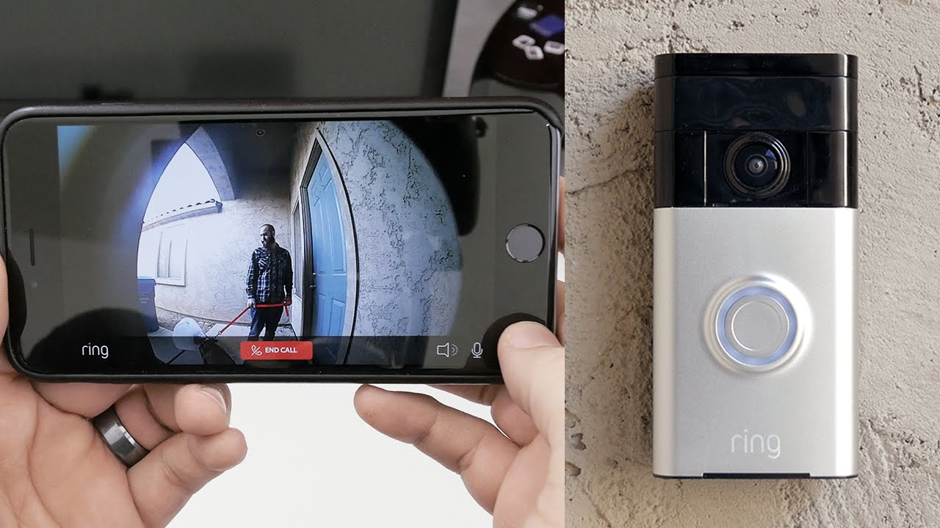
Devices
doorbell camera: Talk to visitors, opens door, records missed guests
garage door openers: Control with smart phone
air quality sensors: Smart phone alerts
oven: temperature probes, camera and food recognition
Refrigerator: Energy regulation

Slide 3
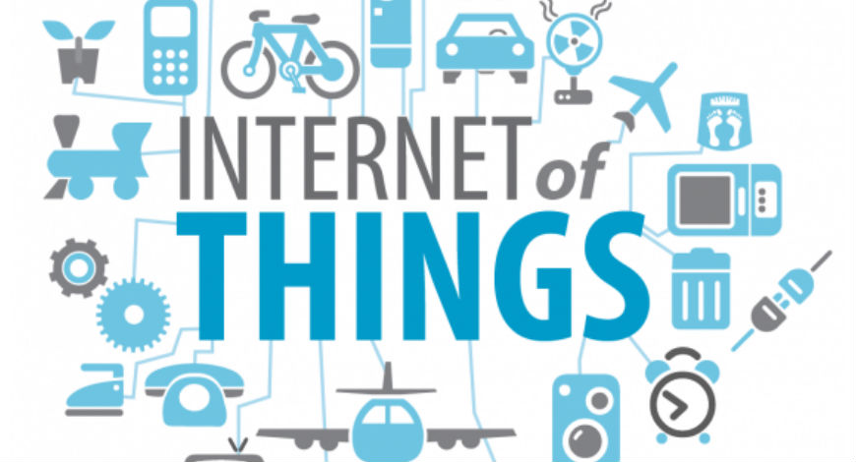
Why the Network?

Slide 4
Firmware
Runs IoT devices
Like permanent software
Vulnerabilities
Not updated often/hard to update
Hardcoded credentials (passwords, etc.)
Failure to encrypt/decrypt data sent over the network

Slide 5
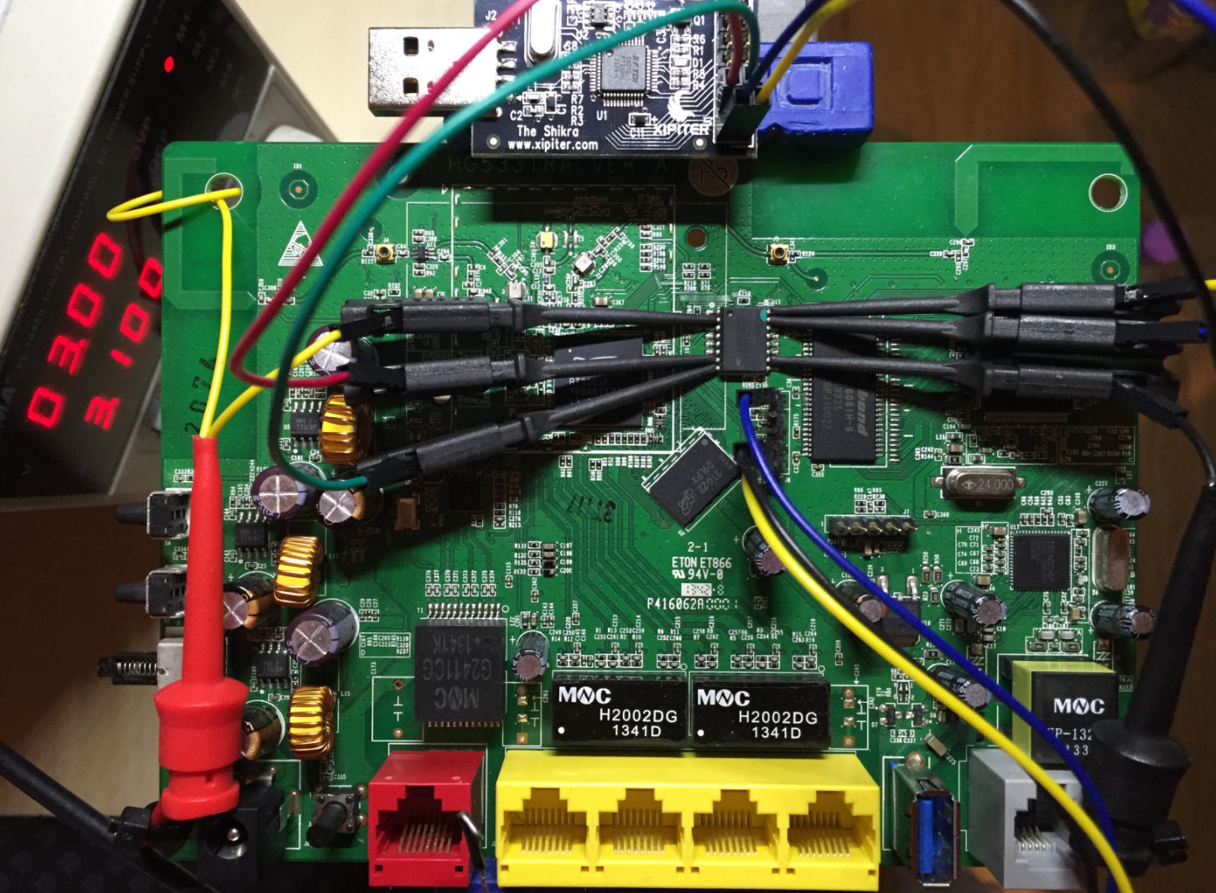
Hacking an IoT device
Obtain the firmware
From the vendor website
Dumping the firmware from the device through hardware exploitation
UART, JTAG, or SPI Flash

Slide 6
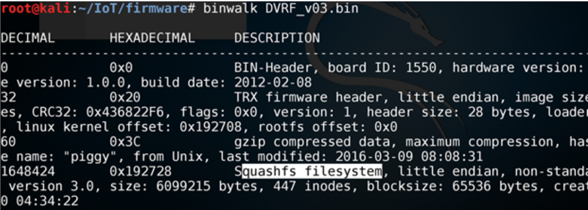
Binwalk
A firmware reverse engineering tool
Notice that the filesystem type is Squashfs. Knowing the type, it can be extracted

Slide 7
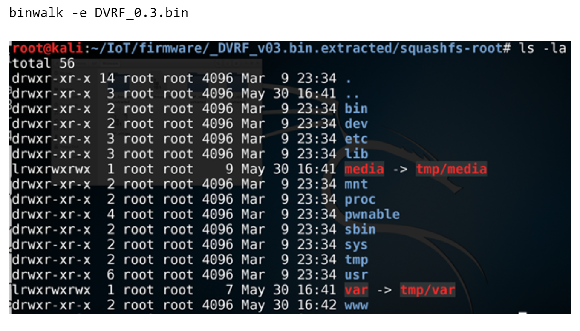
Next step is to identify vulnerabilities

Slide 8
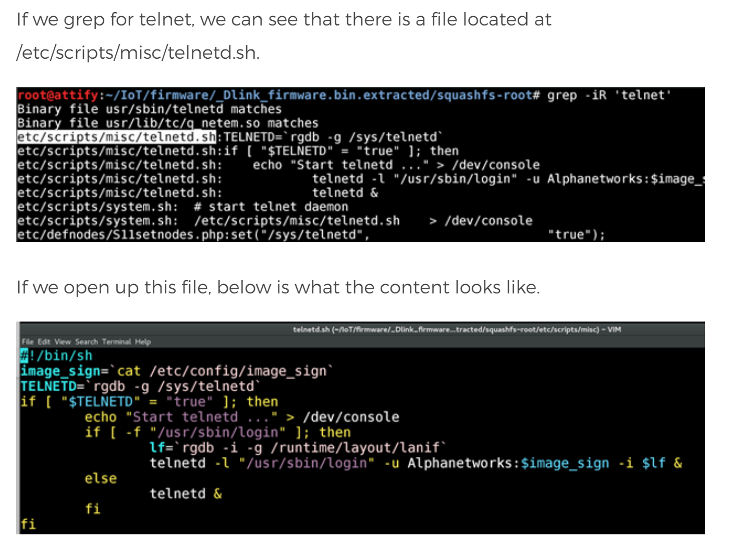
The login credentials hard coded in the image_sign file

Slide 9
We have the login credentials.

Slide 10
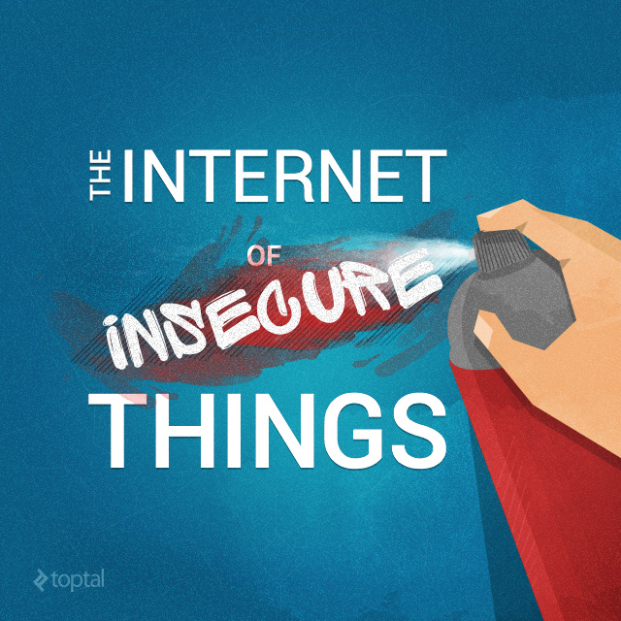
Why so many devices aren’t secure
Most people don’t care whether their refrigerator is hackable or not
As more IoT hacks occur and are published, Consumers will become more concerned, forcing companies to secure their devices better

Slide 11
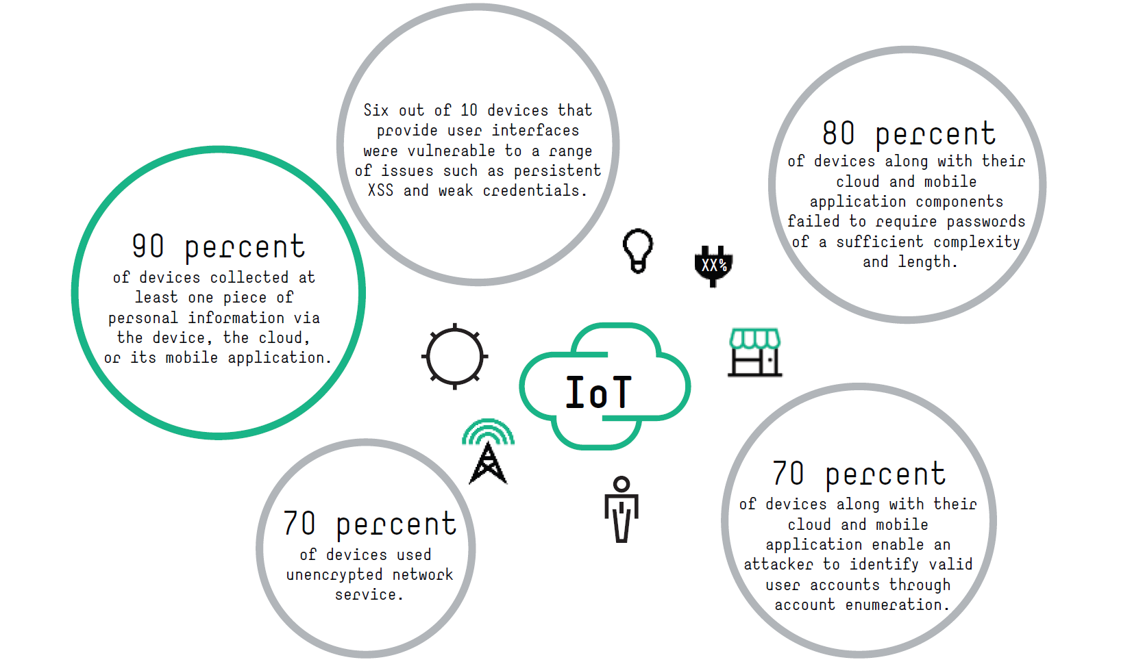
-NSS labs

Slide 12
Arm processors
The company has a goal to have a trillion IoT devices connected by 2035
Impossible goal without industry stability
Releasing open-source code to help secure IoT devices with:
Device identification and authentication
Encrypted communication
Auto downloaded security patches and updates
Provide a trusted boot sequence

Slide 13
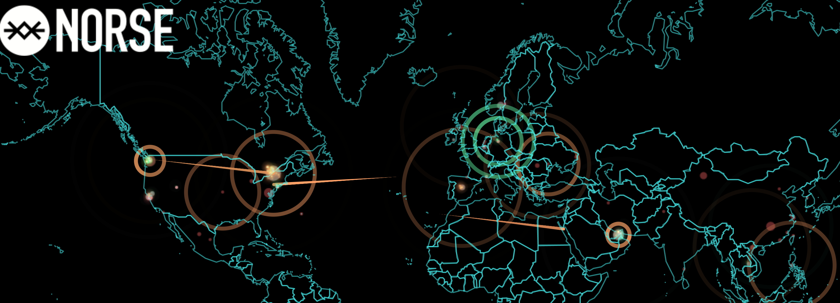
DDOS
Mirai (Japanese for "the future", 未来) is a malware that turns networked devices running Linux into remotely controlled "bots" that can be used as part of a botnet in large-scale network attacks
It primarily targets online consumer devices such as IP cameras and home routers.
(Mikels presentation in round 1)

Slide 14
Jeep hack

Slide 15
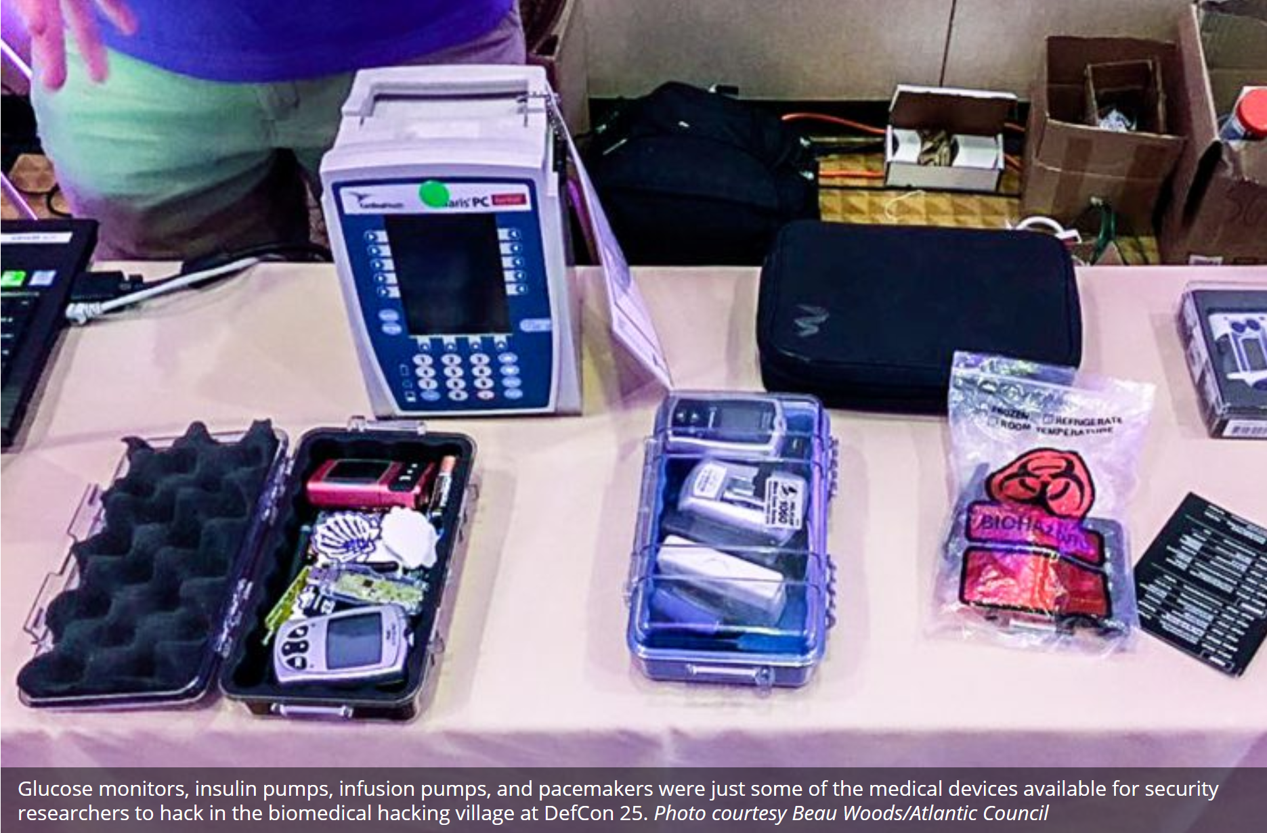
Medical Devices
(see presentation by Alyissa)

Slide 16
Sources
http://resources.infosecinstitute.com/firmware-analysis-for-iot-devices/#gref
https://www.nsslabs.com/company/news/media-resources/iot-insecurity-pinpointing-the-problems/
https://www.datamation.com/mobile-wireless/75-top-iot-devices-1.html
https://www.theregister.co.uk/2017/10/23/arm_platform_security_architecture/
https://en.wikipedia.org/wiki/Mirai_(malware)

