Slide 1
Medical Device Security
Alyissa White

Slide 2
Medical devices
get networking
capabilities
First Internal Pacemaker
1960
FDA approved ICD
1985
First Pacemaker
1928
First Cochlear Implant
1978
Wireless Blood Glucose Monitor
2006

Slide 3
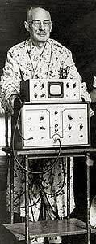
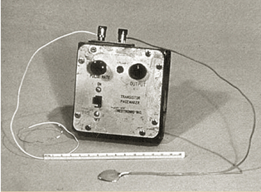
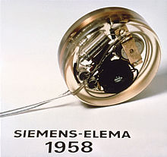

Slide 4
Pacemaker vulnerability
Aug 2017 FDA approved software update affecting 465k pacemakers
Anyone could have been accessed through readily available equipment
There was no authentication to get into the device
Side Affect - Rapid Battery Depletion - Intentional Arrhythmia

Slide 5
Whitescope
May 2017 Released article
8,000 known vulnerabilities
Necessary equipment available via auction

Slide 6
Lets go shopping…
Programmer: https://www.ebay.com/itm/St-Jude-Medical-3510-Pacemaker-Programmer-with-Warranty/253402698911?hash=item3afffa549f:g:J7wAAOSwISRac2N-
Cheap one: https://www.ebay.com/itm/St-Jude-Medical-3510-Programer/183036895332?hash=item2a9dd96064:g:OR4AAOSwUg9aaleV
Rapid Programmer: https://www.ebay.com/itm/ST-JUDE-MEDICAL-Model-3851-Rapid-Programer-3805-Pads-Bundle-Set-New-Used/222939720892?hash=item33e83e2cbc:g:oB0AAOSwealaZTnl
Pace Maker: https://www.ebay.com/itm/Medtronic-Elite-II-DDDR-Model-7086-NOT-FOR-HUMAN-USE-SALESMAN-SAMPLE-PACEMAKER/222937922821?hash=item33e822bd05:g:9lcAAOSwVWpa2-ur
How to use: https://www.youtube.com/results?search_query=how+to+program+ensurity+pacemaker

Slide 7
Insulin Pump Vulnerability
114K with OneTouch pump in United States
Radio Frequency Vulnerability
Pump uses packets for commands
No authentication
Operates on 14 frequencies

Slide 8
https://www.youtube.com/watch?v=NdMl1xcQsPs

Slide 9
More Shopping …
Monitors: https://www.ebay.com/sch/i.html?_from=R40&_trksid=p2380057.m570.l1311.R1.TR3.TRC0.A0.H0.Xonetouch+glu.TRS0&_nkw=one+touch+glucose+meter&_sacat=0
Remote Access Device: https://www.onetouch.com/products/insulin-pumps/onetouch-ping-glucose-management-system#product-overview
Radio Transmitter: https://www.adafruit.com/product/3583

Slide 10
https://www.heart.org/HEARTORG/Conditions/Arrhythmia/PreventionTreatmentofArrhythmia/Implantable-Cardioverter-Defibrillator-ICD_UCM_448478_Article.jsp
https://www.nidcd.nih.gov/health/cochlear-implants
https://www.ncbi.nlm.nih.gov/pmc/articles/PMC3232561/
https://www.fda.gov/MedicalDevices/Safety/AlertsandNotices/ucm573669.html
https://www.youtube.com/watch?v=rBlgho73agA
http://blog.whitescope.io/2017/05/understanding-pacemaker-systems.html

