Slide 1
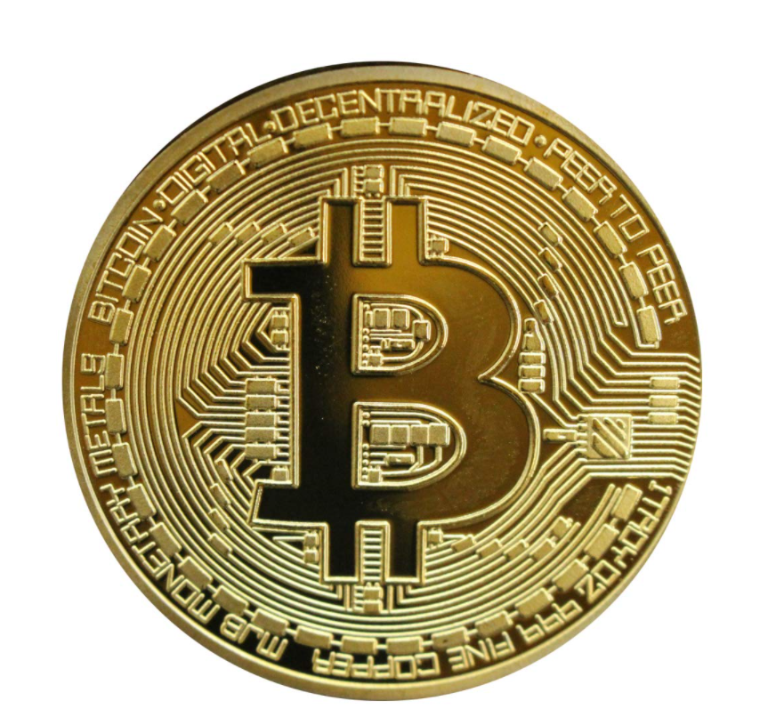
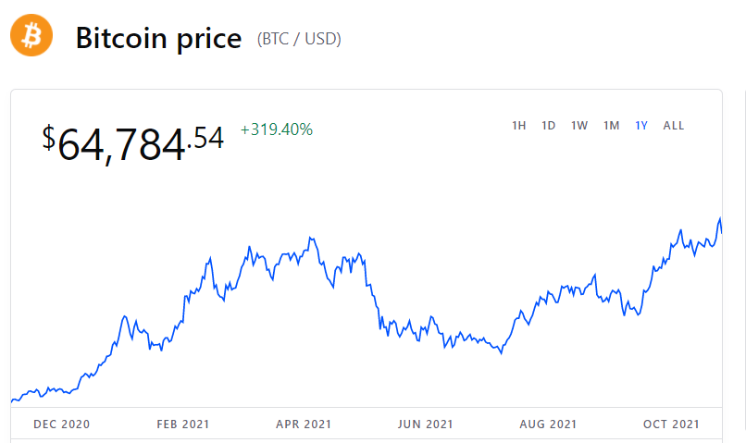
Make Money Bitcoin is Just A Tool
Changrui Li

Slide 2
Overview
Black market, grey market, bitcoin, “black card”, Apple gift card
Process for making money using bitcoin with Apple gift card example
Government thinking of bitcoin

Slide 3
Black Market
A black market is a transaction platform, whether physical or virtual, where goods or services are exchanged illegally. ... For example, while neither buying nor selling food is illegal, the transaction enters the black market when the good sold is illegal.
The people who has the needs of anonymous transaction will need the black market.

Slide 4
Grey Market
A gray market is an unofficial market for financial securities. Gray (or “grey”) market trading generally occurs when a stock that has been suspended from trades off the market, or when new securities are bought and sold before official trading begins. ... The gray market is an unofficial one but is not illegal.
People that like to increase the sales of their products will like this grey market.

Slide 5
Bitcoin
Bitcoin is a decentralized digital currency, without a central bank or single administrator, that can be sent from user to user on the peer-to-peer bitcoin network without the need for intermediaries.
Feature: Transaction details visible to public, user info(wallet address) encrypted.
Where to buy? Bank, platform, person.
Purpose: investment, asset risk transfer(Wall Street, Goldman Sachs, rich people),etc.
*Transactions unrelated to your payment due to peer to peer

Slide 6
“Black Card”
The privileges of a black card include upgrades and special permissions for rental cars and access to some of the most breathtaking hotel suites in hard-to-reach destinations. Black cards also offer private concierge service, and some are even rumored to provide charter jet service.
Gift Card generated by a counter
In this case, never pay back to the issue bank for the black card
This will cause bad debts

Slide 7
Gift Card
A gift card is a form of payment that can be used to make purchases at retail stores, gas stations, restaurants, and other locations. for example, Apple Gift Card
Scammers love them, too. It gives them numerous, virtually untraceable ways to steal.
Once it's spent, you almost certainly can't get it back. Fraudsters have developed two distinct ways to exploit that fact: gift card payment scams and outright gift card theft.

Slide 8
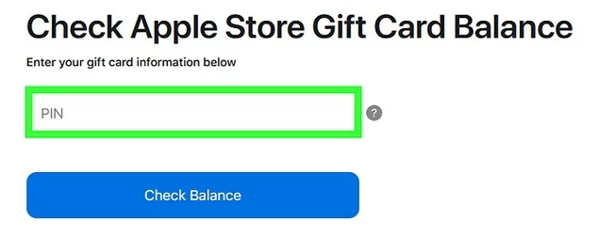
Process
Seller
Resources: goods by using black card, Apple gift card, etc., gift card calculator(calculate card number and pin), steal, low rate from other sellers
Buyer
holding wealth with bitcoin in advance(meaning invest early in bitcoin)
Holding platform/game to sell the goods that purchased from the sellers
Selling in games with no cost, because the bitcoin is almost no cost to buyer
Middle part
Having an account or response for using the platform
Purchase gems in game with game account that buyer provided
Confirm the Apple gift card information in this case

Slide 9
Example (the communication in encrypted system like peer to peer)
Seller: Good morning, bro, I have an Apple gift card($100) for $90, would like to buy it?
Buyer: Sure thing, let me take a look.
……
Seller send picture of the gift card to buyer, then buyer transfer to the middle part, to confirm the gift card has the value, then return to the buyer. If all good, buyer pay seller the same value of bitcoin(with only how much bitcoin send to the seller). Buyer will also pay middle part partial amount of benefit from seller itself.
During this period, Apple will only recognize that middle part was using the gift card and link the account to that gift card, remember this.
Later, middle part spend all value store in the apple account for buying gems in games with game account that buyer provided.
Then, buyer sell their gems to other peoples to make money.

Slide 10
At this point, you may find, the only information that is traceable is middle part’s Apple account and Apple gift card.
Information from buyer and seller are invisible, because the payment and Apple gift card usage are not linked.
There is a little more happened after the transaction.

Slide 11
One day, middle part’s account suddenly banned. Later, find out it is because the Apple gift card is recalled by the seller or pervious holder of it.
If the Apple account is middle part’s main account, it will be a big problem that the person will lose benefit like using App Store and can no longer purchase and download any app even the purchased from the platform.
In the whole process, seller earned bitcoin, buyer gain real money(fiat currency), middle part earn a little but lose their account benefits.

Slide 12
Government doesn’t like bitcoin
Recently, Chinese government just say no to bitcoin, because it is not good for economy growth. Bitcoin doesn’t own a real value in it, not even like golds.
Also, it is not controlled by government that government can control it within macro level.
Bitcoin can be used by criminals to transfer their wealth like making business in dark.
Also, it can help people manage their investment to circumvent capital controls(prevent protection for rich people, good for people do risk control but not good for government control their money). Lockdown makes Wall Street no where to go, then go bitcoin which does not cost a lot.

Slide 13
Question?

Slide 14
Reference:
https://www.amazon.in/Gold-Bitcoin-Commemorative-Plated-Copper/dp/B00J2B0KEO
https://www.coinbase.com/price/bitcoin
https://apnews.com/article/technology-business-bitcoin-f6d7ba724bf156fd5d603661c99fd5c2
https://www.wikihow.com/Check-an-Apple-Gift-Card-Balance
https://twitter.com/bradfitz/status/885288352244576256
https://www.aarp.org/money/scams-fraud/info-2019/gift-card.html

