Slide 1


Surfzone Bathymetry Estimation using Unmanned Aerial Systems
Jesse McDonald
Jason Pollard
Mentored by Dr. Michael J Starek and Dr. Kar Dulal
Thanks to Kevin Wilson
Texas A&M - Corpus Christi

Slide 2
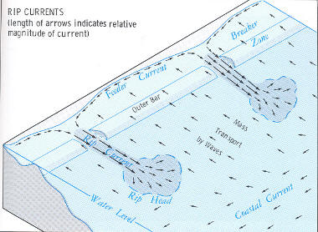
Introduction
Bathymetry
  Measurement of water depth
    Oceans, seas, or lakes
  Sandbars
Motivation
  Surveying
  Beach conservation research
  Rip current detection
    80% beach fatalities
    100x more dangerous than shark attacks
Rip current bathymetry http://www.ripcurrents.com/ripcurrents101.html

Slide 3
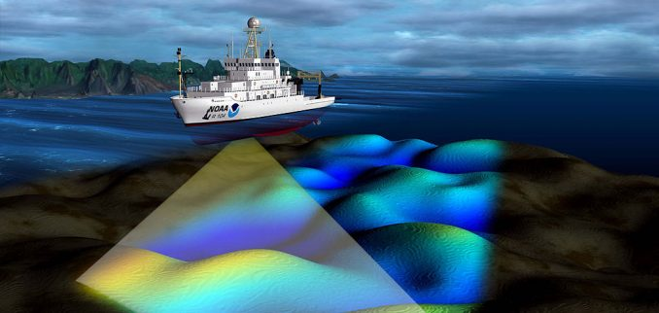
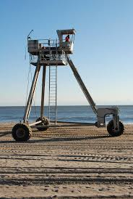
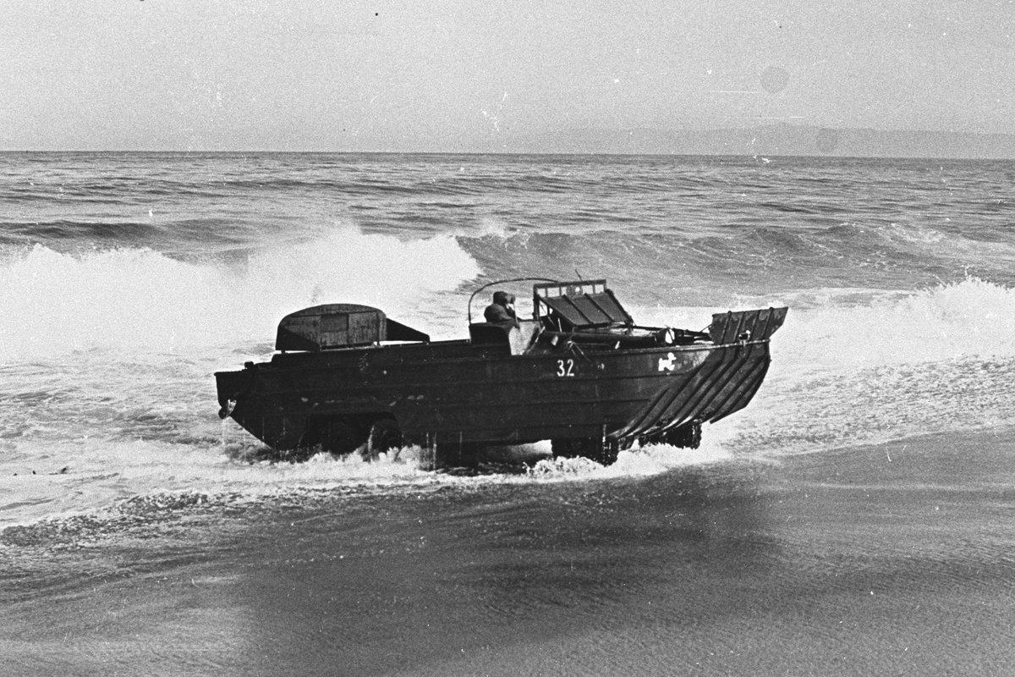
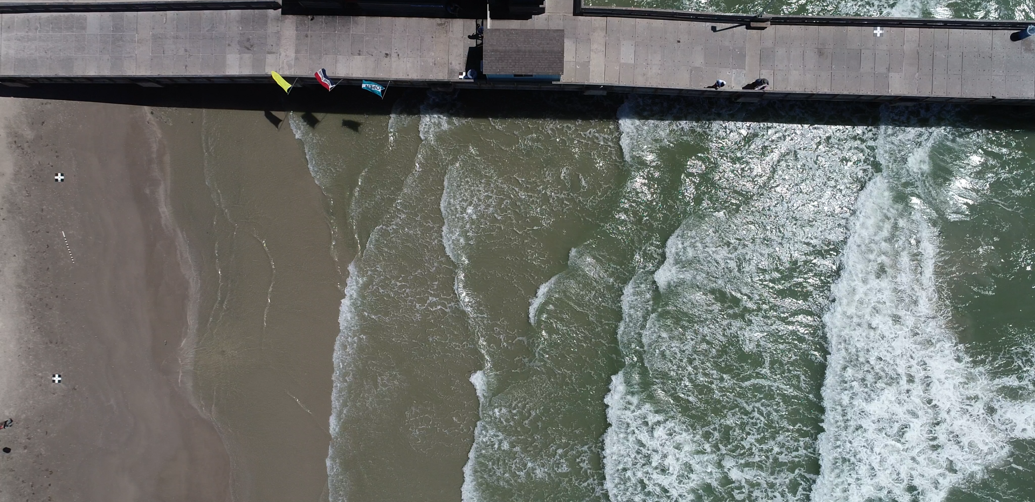
Limits of Traditional Methods
Sonar
  Requires large ship
  Thrown off by waves
  Too large for surfzone
Traditional Surveying
  Slow, Tedious, Expensive, Dangerous
  Equipment is expensive
  Higher environmental impact
Lidar
  Requires crystal clear water
  Water bends light
  Waves are even worse
Coastal Research Amphibious Buggy
C.R.A.B
https://gisgeography.com/mapping-the-ocean-floor-water-bathymetry-data/
Duck Amphibious Vehicle
https://www.tankmuseum.org/home
http://www.frf.usace.army.mil/crab.html

Slide 4

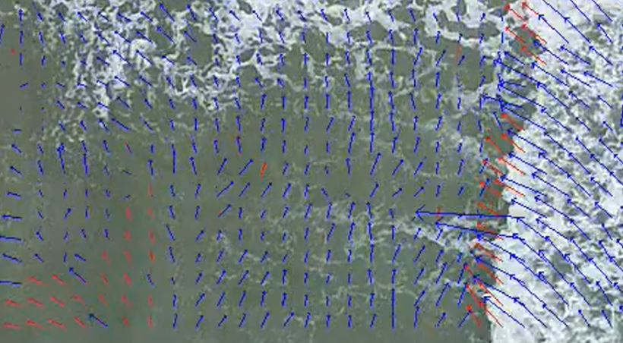
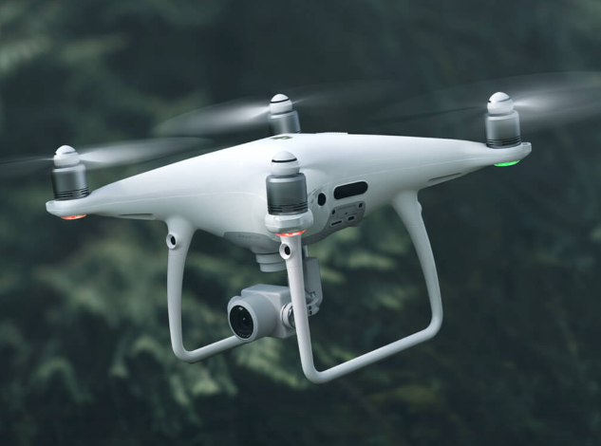
Introduction
Wave Bathymetry Equation
  Estimates wave velocity from water depth
  Run it backwards!
Particle Image Velocimetry (PIV)
  Method used for determining the velocity of particles in fluids
  Traditionally uses seeded tracer particles
Unmanned Aerial Systems (UAS)
  Used to capture surfzone video
  Phantom 4 Pro
Higher Frame Rate vs. Lower Frame Rate
  Which has the best impact on outcomes?
    60fps, 30fps?
Flight Altitude Above Ground Level (ABG)
  Is there a best elevation to capture images?
    75m, 50m?

Slide 5
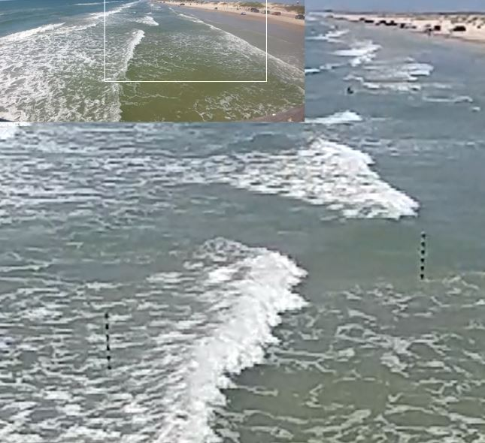
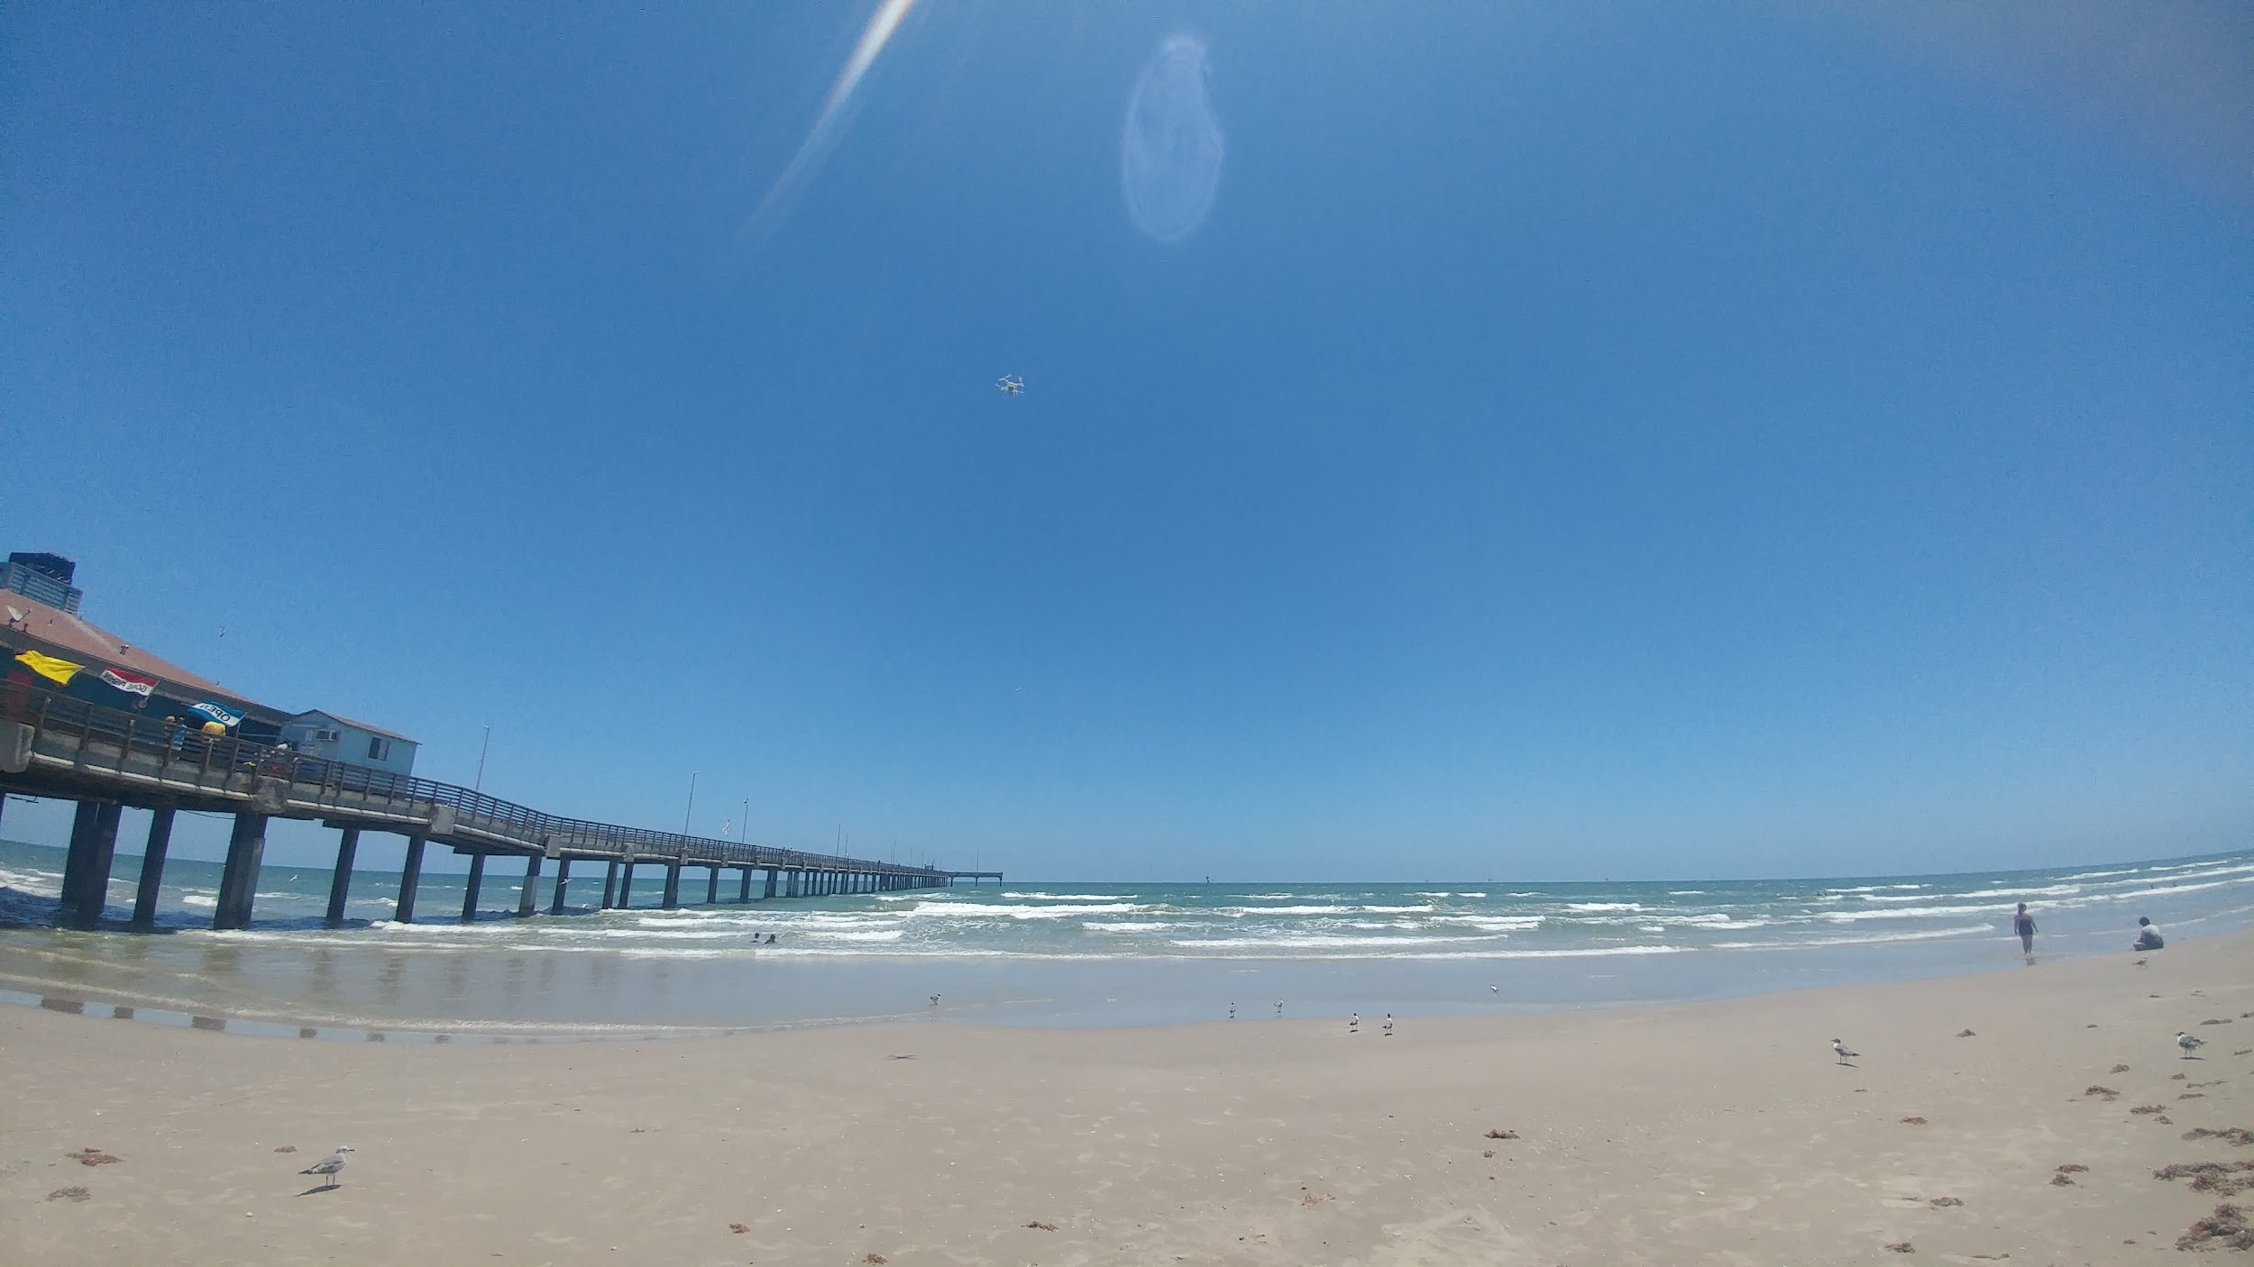
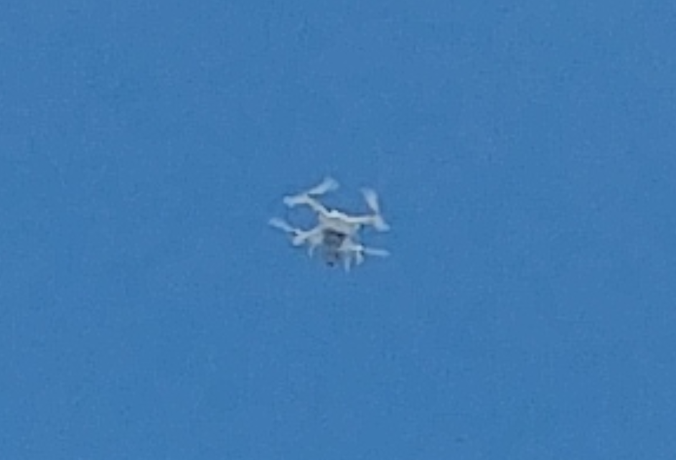
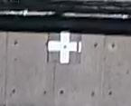
Setup
Depth Measuring Tools
Depth Measuring tools
  Striped every 10cm
Ground Control Targets
  Surveyed in references
Ground Control Target
DJI Phantom 4 Pro
Bob Hall Pier

Slide 6
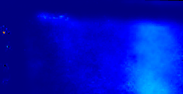
Water Depth Inverted from Wave Velocity
Current automated method
  Average velocities
  Run bathymetry on average
Automated issues
  Only data at wave crest is needed
  Depth off by nonuniform linear constant
Still useful
  Finds sandbar geometry
  Known depths allow the constant to be found
Lighter = Deeper

Slide 7
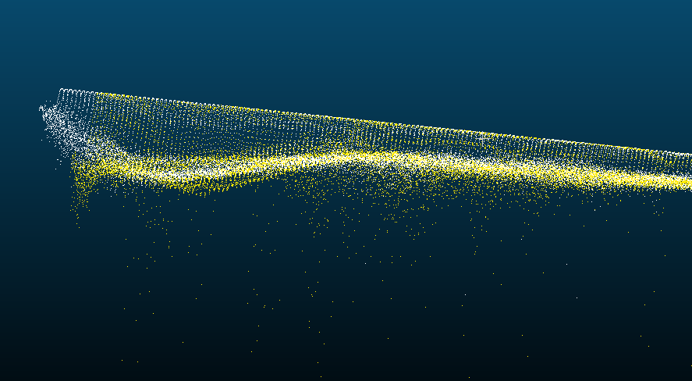
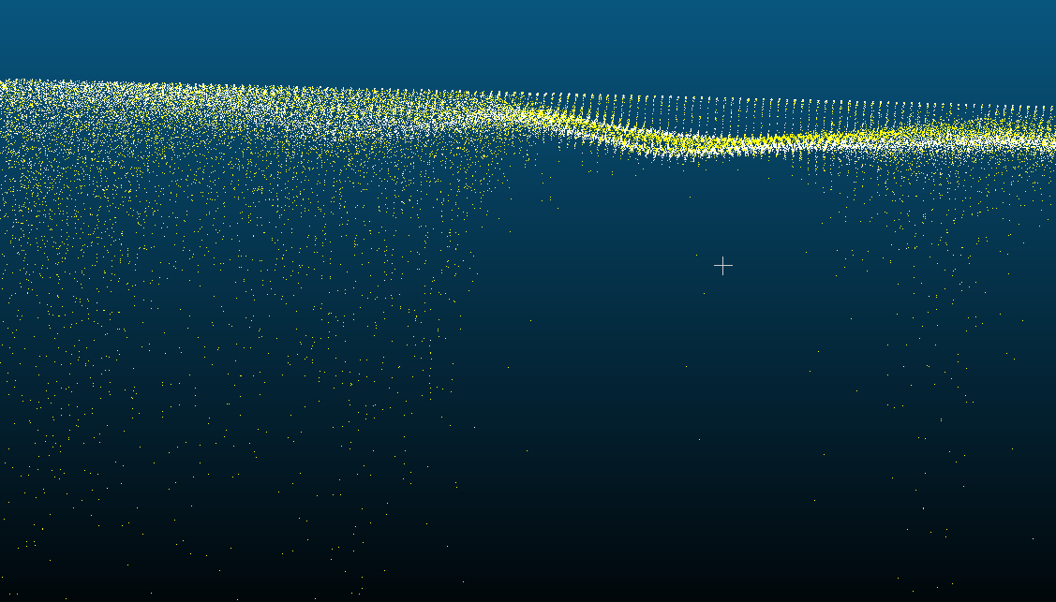
50m Point Clouds 75m Point Clouds
60fps
30fps
60fps vs 30fps
60fps vs 30fps
Side View
Side View
60fps
30fps

Slide 8
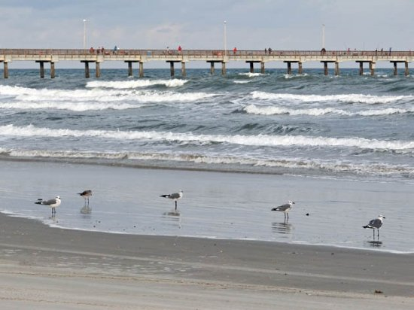
Conclusions
PIV conceptually Good
Use Lower Framerates
Use Ground Truth Poles
  Buried 1/3rd pole length
  Checked between flights

Slide 9
Acknowledgements
Special thanks to the NSF for the REU opportunity that funded this research and Texas A&M Corpus Christi for hosting the site.
Dr. S. Long at Lewis-Clark State College and INBRE grant P20GM103408 for use of the data processing server
Kevin Wilson at TAMUCC for piloting the UAS
Data and code available at http://isoptera.lcsc.edu/~jamcdonald/reu/

Slide 10
Presentation References
Brouwer, R. L., De Schipper, M.,A., Rynne, P. F., Graham, F. J., Reniers, A. J. H. M., & Macmahan, J. H. (2015). Surfzone monitoring using rotary wing unmanned aerial vehicles. Journal of Atmospheric and Oceanic Technology, 32(4), 855-863.
Chapman, H., & O’Connor, H. (2019). Particle Image Velocimetry to Determine Wave Properties using Unmanned Aerial Systems. Submitted for publication.
Sun, Shih-Heng, et al. “Imaging-Based Nearshore Bathymetry Measurement Using an Unmanned Aircraft System.” Journal of Waterway, Port, Coastal, and Ocean Engineering, vol. 145, no. 2, 2019, p. 04019002., doi:10.1061/(asce)ww.1943-5460.0000502.

Slide 11
Paper Sources
[6] M.J. Starek, T. Davis, D. Prouty, and J. Berryhill, “Small-Scale UAS for Geoinformatics Applications on an Island Campus,” Ubiquitous Positioning Indoor Navigation and Location Based Service (UPINLBS), pp. 120-127, IEEE, Nov. 2014.
[7] M.J. Starek, and J. Giessel, July. Fusion of UAS-Based Structure-From-Motion and Optical Inversion for Seamless Topo-bathymetric Mapping,” IEEE International Geoscience and Remote Sensing Symposium (IGARSS), pp. 2999-3002, IEEE, 2017.
[8] R. Slocum and C. Parrish, “Simulated imagery rendering workflow for UAS-based photogrammetric 3D reconstruction accuracy assessments,” Remote Sensing, vol. 9.4, pp. 396, 2017.
[9] S. Sun, W. Chuang, K. Chang, K. Young, J., Kaihatu, T. Huff, and R. Feagin, “Imaging-Based Nearshore Bathymetry Measurement Using an Unmanned Aircraft System,” Journal of Waterway, Port, Coastal, and Ocean Engineering, vol. 145.2, Mar. 2019.
[10] H. O’Connor and H. Chapman, “Particle image velocimetry to determine wave properties using unmanned aerial systems,” School of Engineering and Computing Sciences, Texas A&M University-Corpus Christi, Corpus Christi TX, USA, Tech. Report, 2018.
[11] Z. Taylor, R. Gurka, G. Kopp, A. Liberzon, “Long-Duration Time-Resolved PIV to Study Unsteady Aerodynamics,” IEEE Transactions on Instrumentation and Measurement, vol. 59, no.12, pp. 3262-3269, Dec. 2010.
[1] T. Kearns, and Joe Breman, "Bathymetry-The art and science of seafloor modeling for modern applications." Ocean globe, pp. 1-36, 2010.
[2] J. Dugan, W. Morris, K. Vierra, C. Piotrowski, G. Farruggia, D. Campion, “Jetski-based nearshore bathymetric and current survey system,” Journal of Coastal Research, 17, pp. 900-908, 2001.
[3] T.C. Lippmann and R. A. Holman. "The spatial and temporal variability of sand bar morphology." Journal of Geophysical Research: Oceans, vol. 95.c7, pp. 11575-11590, 1990.
[4] "How to Avoid Getting Caught in a Rip Current," National Weather Service, Mar. 2019. [Online]. Available: https://www.weather.gov/safety/ripcurrent. [Accessed Jun. 15, 2019].
[5] M.J. Westoby, J. Brasington, N. Glasser, M. Hambrey, and J.M. Reynolds, “‘Structure-from-Motion’Photogrammetry: A Low-Cost, Effective Tool for Geoscience Applications,” Geomorphology, 179, pp. 300-314, 2012.

